Slide 1
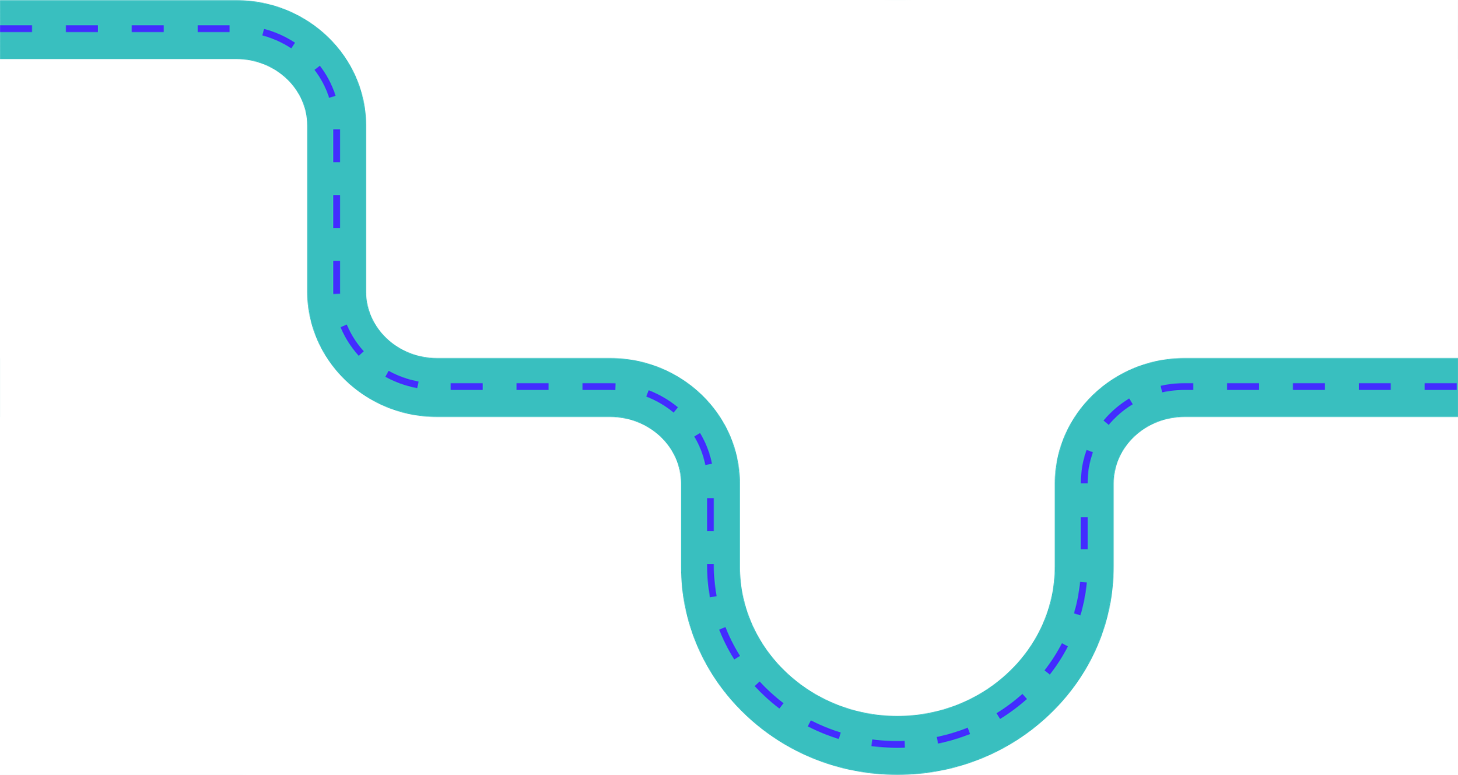







IDENTIFYING OPPORTUNITIES FOR RIVER RE-MEANDERING
By (names removed for anonymity)

Slide 2
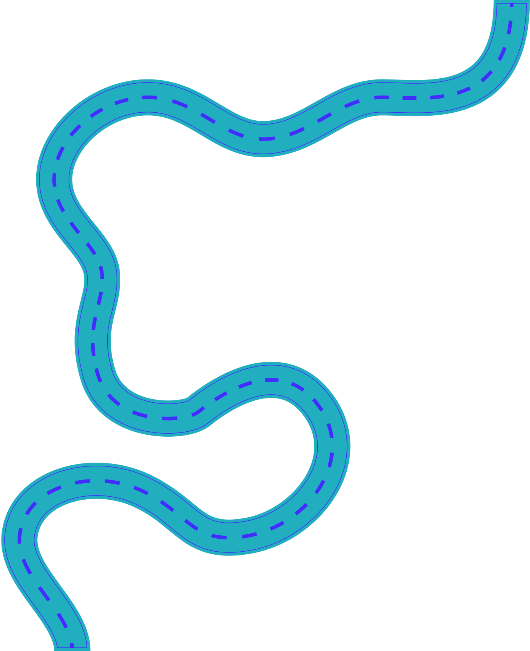
BACKGROUND
Human activity has changed the UK river system beyond recognition – 97% of the river system in the UK is fragmented and over 99% has man-made barriers (Jones et al, 2019)
In 1750, Britain had approximately 1400 miles of navigable rivers, but by 1830, approximately 2500 miles of canals had been built (Soar and Thorne, 2001)
River straightening/channelisation has had significant negative environmental effects

Slide 3
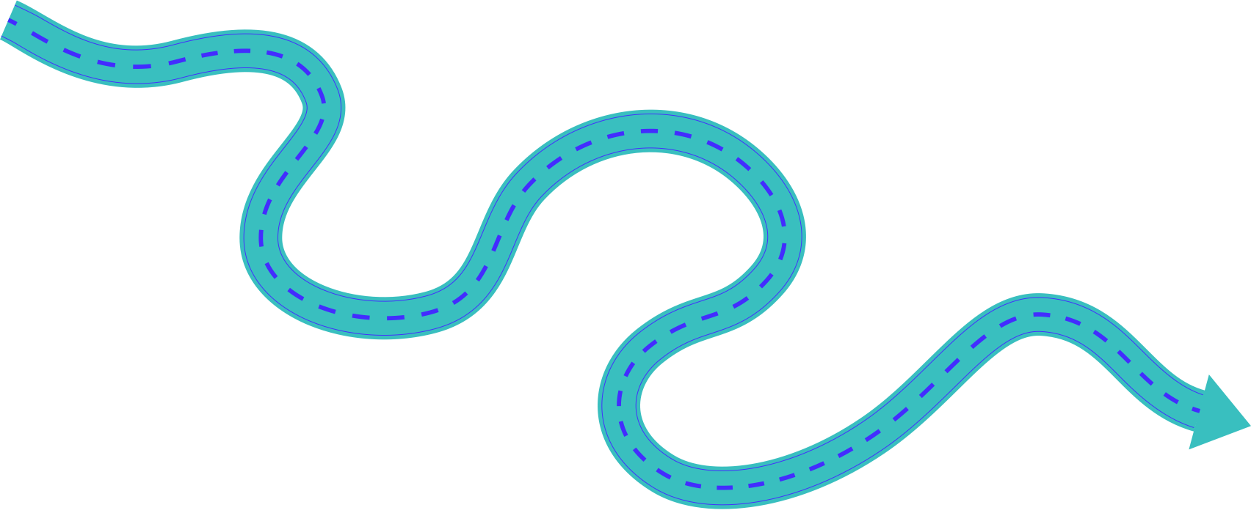

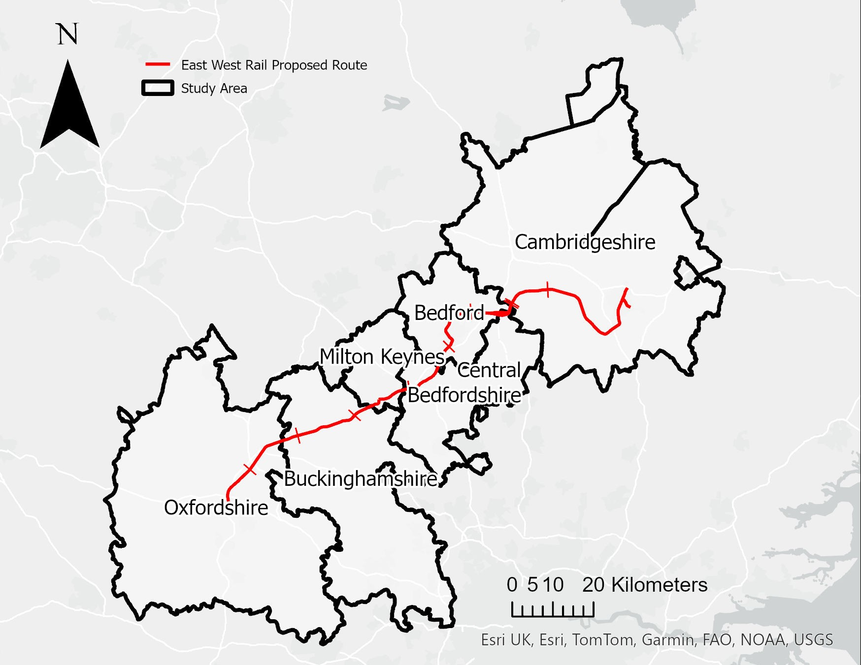
STUDY AREA
Development of East West Rail line gives real opportunities for improving local waterways
Population of 2.7 million (2021 Census)
Only 1.3% of people living in this area use the train as their main way of getting to work (2021 Census)

Slide 4
DATA DESCRIPTION
Name | Description | Accessed From
OS Zoom Stack | GeoPackage | https://osdatahub.os.uk/downloads/open/OpenZoomstack
East West Rail | Route Centreline GIS File | https://eastwestrail.co.uk/consultation2024#block-1944
Land Cover | Shapefile | https://digimap.edina.ac.uk/environment
Flood Risk Areas | Shapefile | https://environment.data.gov.uk/explore/f3d63ec5-a21a-49fb-803a-0fa0fb7238b6?download=true
Provisional Agricultural Land Classification | Geopackage | https://naturalengland-defra.opendata.arcgis.com/datasets/Defra::provisional-agricultural-land-classification-alc-england/about
Counties and Unitary Authorities (May 2023) Boundaries UK BGC | Shapefile | https://www.data.gov.uk/dataset/85228aec-fe0e-49bf-9455-df000d61e731/counties-and-unitary-authorities-may-2023-boundaries-uk-bgc
Inland Navigation in England and Wales before 1348 | Shapefile | https://archaeologydataservice.ac.uk/archives/collections/view/1003427/downloads.cfm?archive=GIS
LIDAR | TIF | https://digimap.edina.ac.uk/lidar
Notes:
So here are the data that we used, including LiDAR, flood risk areas, agricultural land classification, and more.

Slide 5
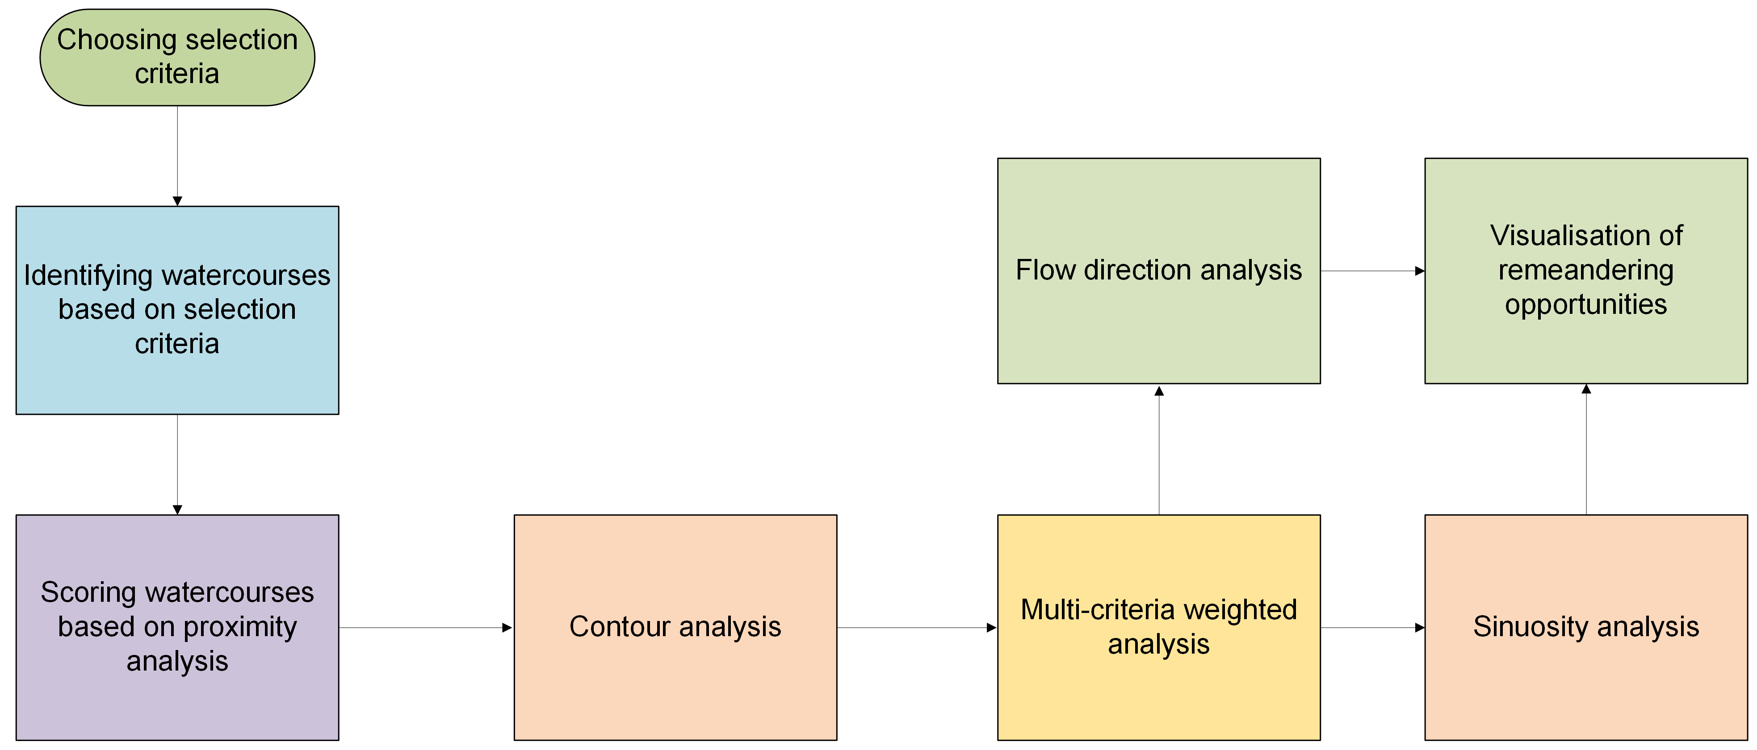
METHODS
Watercourses Definition: Lines representing rivers, canals, drains and other linear bodies of water
Notes:
For our methods, we first chose our selection criteria based on…
We then identified watercourses that fit this criteria using an elimination process. Watercourses are defined as lines representing river, canals, and other linear bodies of water. The selected watercourses were then scored using proximity analysis, then we used four different types of analysis to get to our final visualisations and watercourses for remeandering: contour analysis, multi criteria weighted analysis, flow direction and sinuosity.

Slide 6
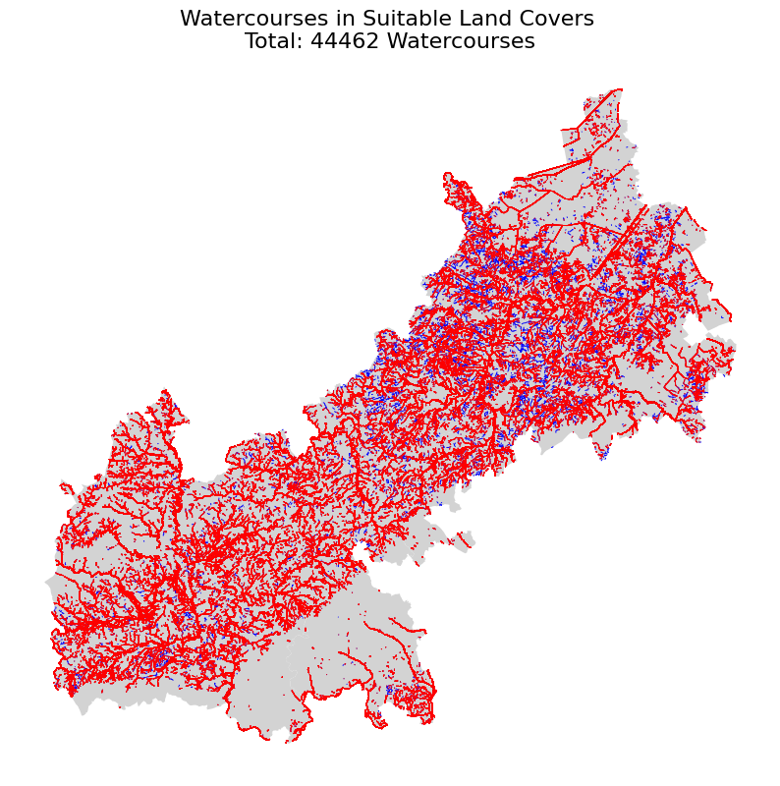
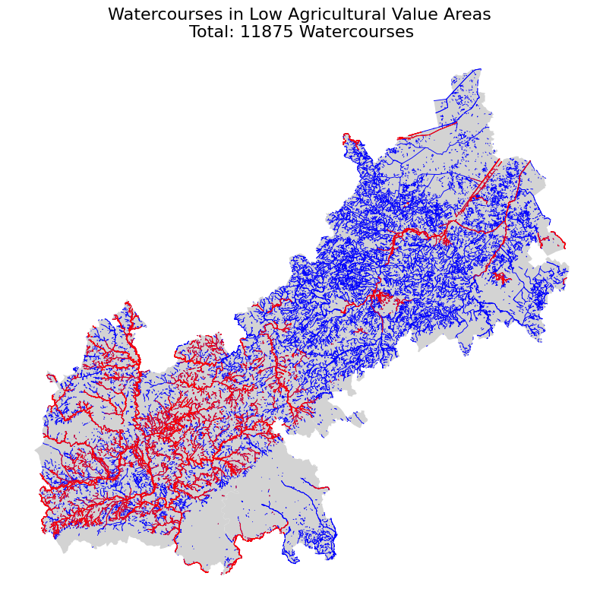
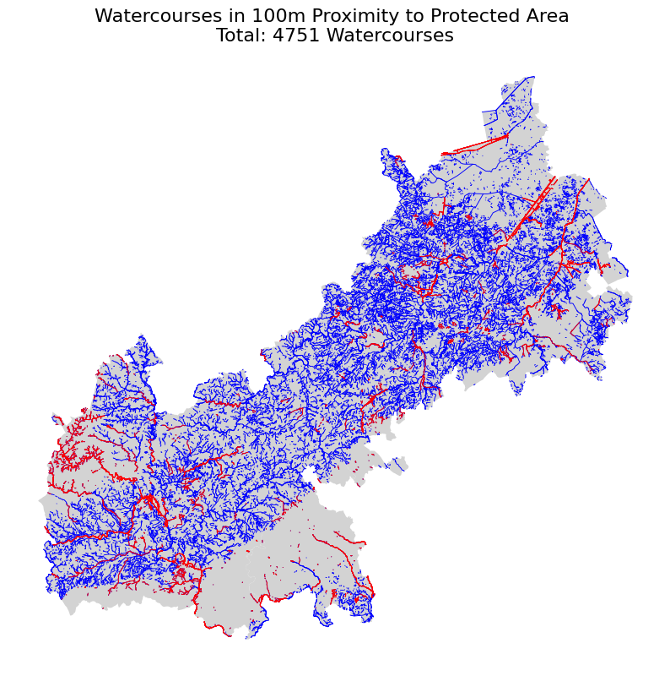
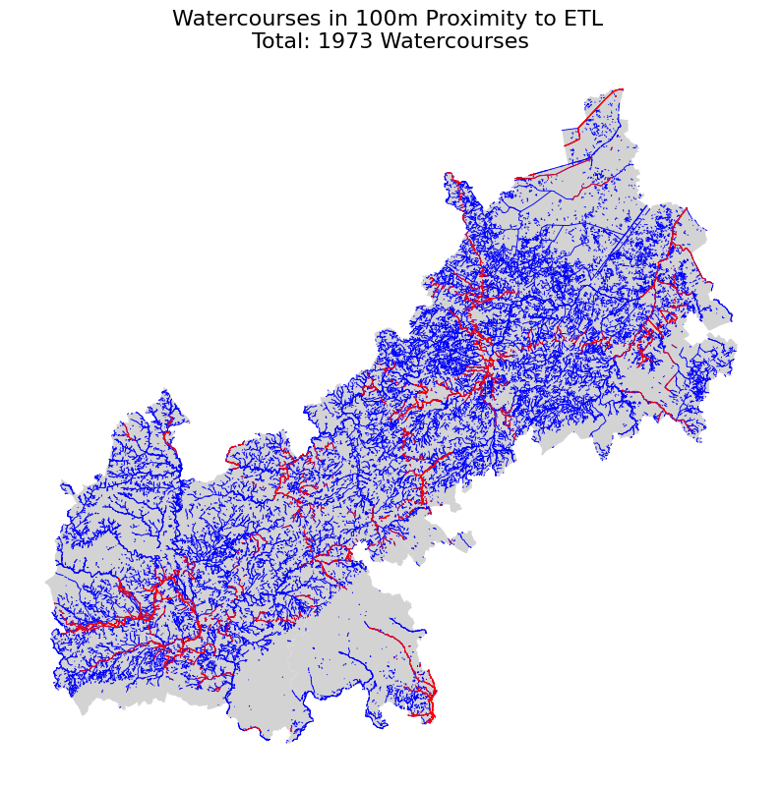
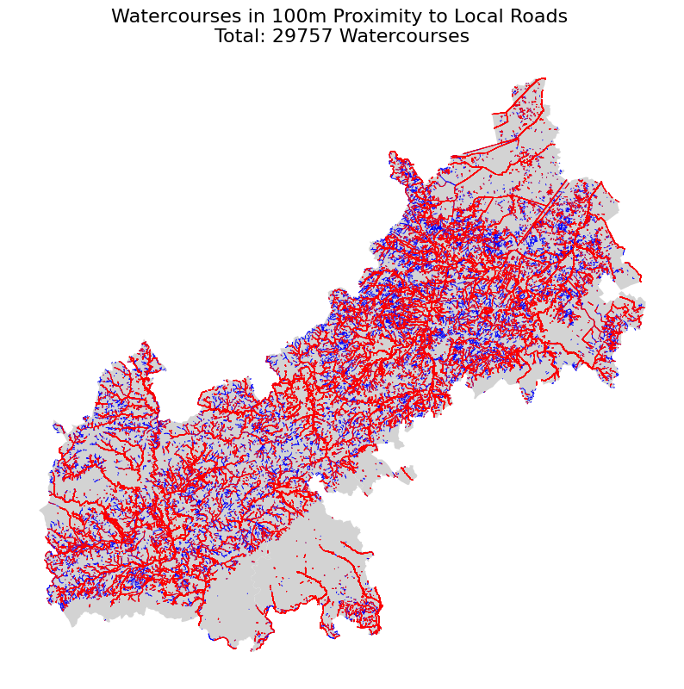
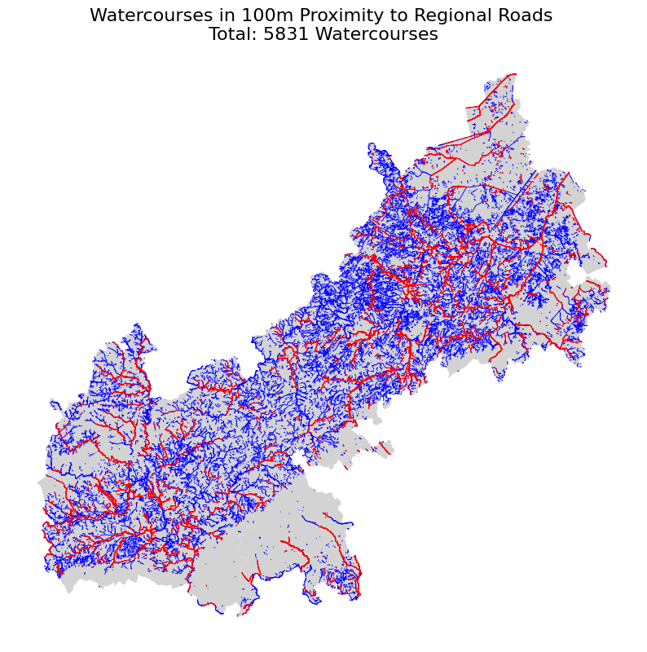
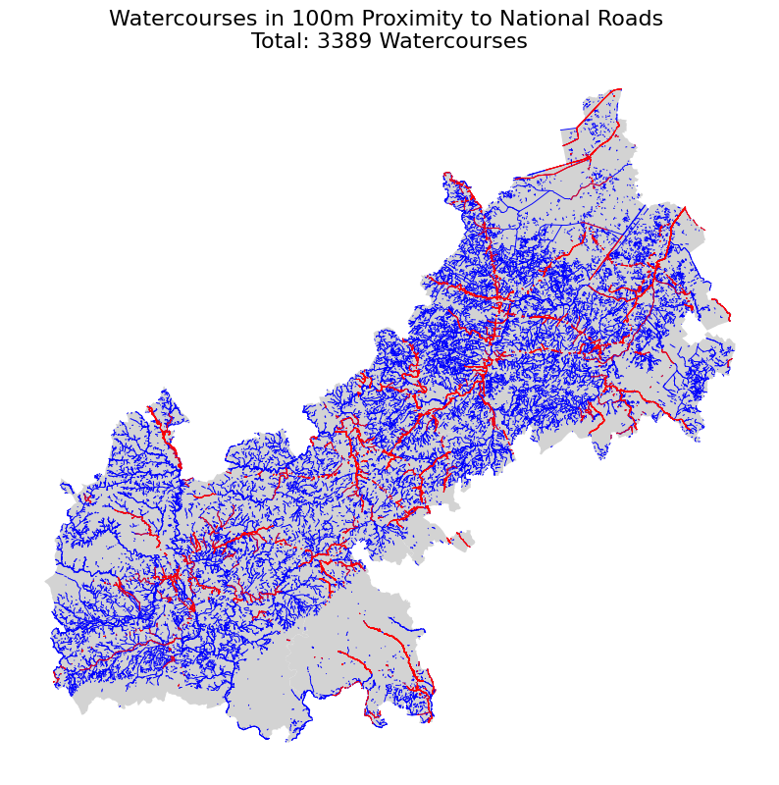
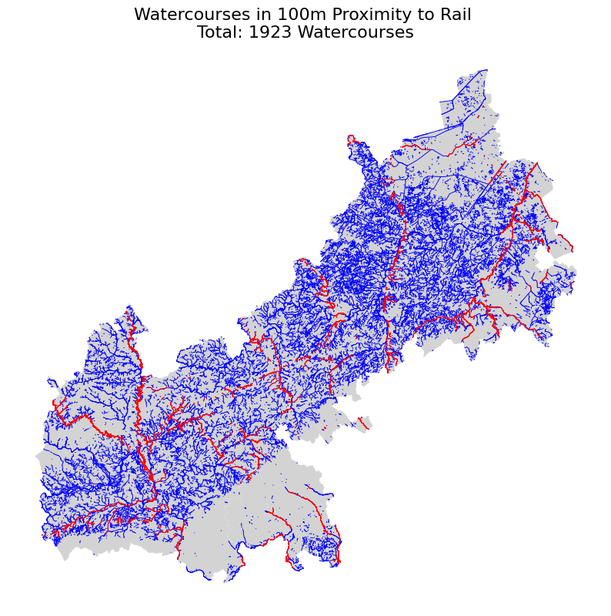
SELECTION CRITERIA

Slide 7
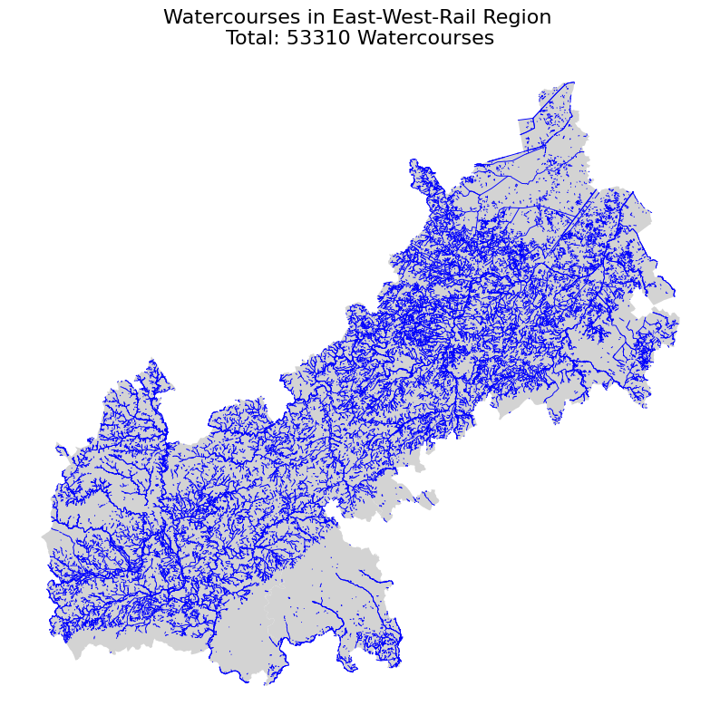
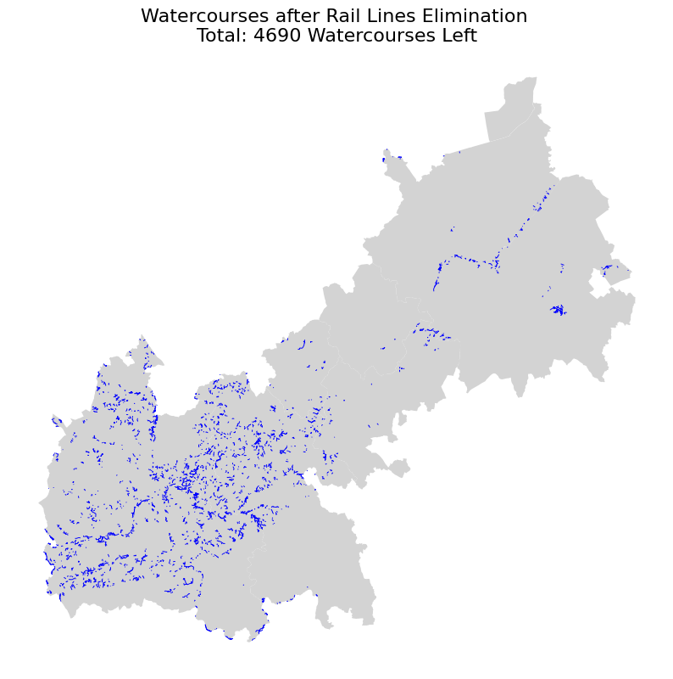

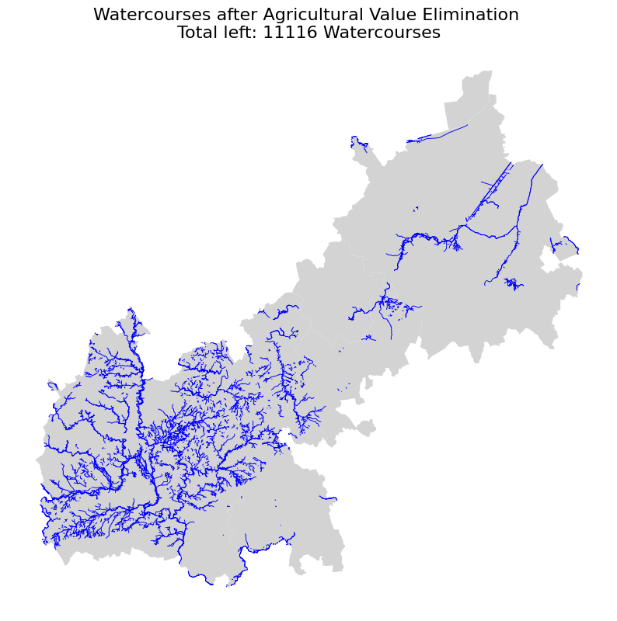
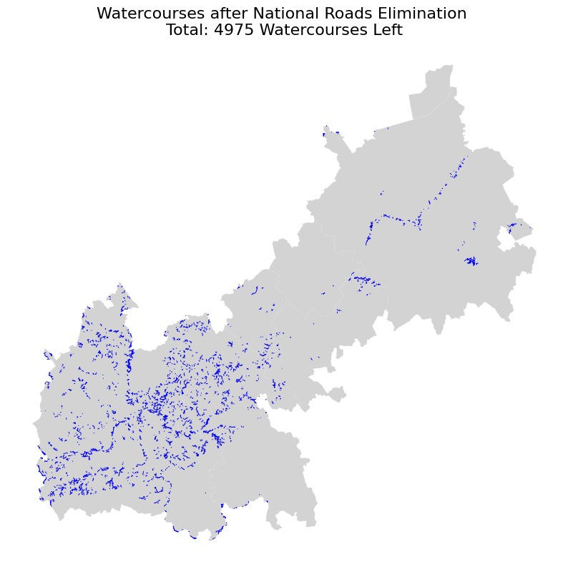

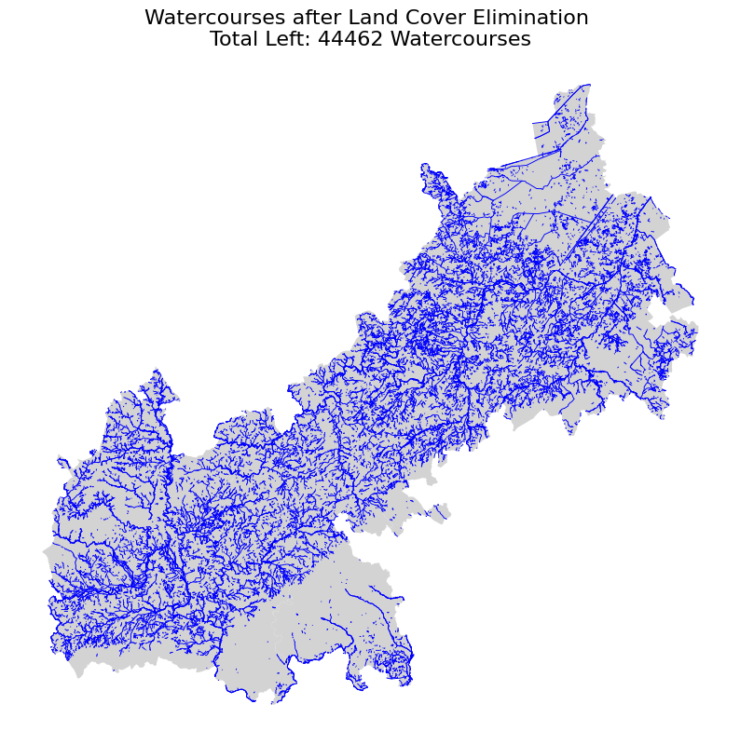
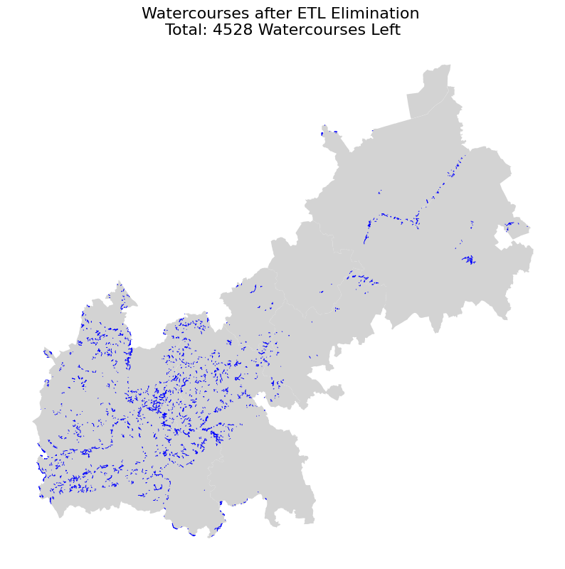
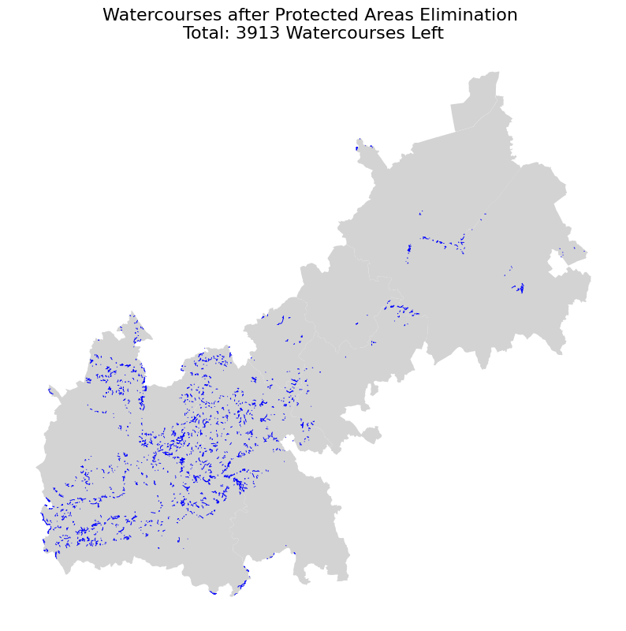
SELECTION PROCESS
Watercourses were eliminated based on their 100m promixity to:
Unsuitable land covers (urban, woodlands, rock, etc)
High-quality agricultural land (Grade 1, 2 and 3)
Protected areas
Roads (local, regional, national)
Rail lines
ETL (Electricity Transmission Lines)

Slide 8
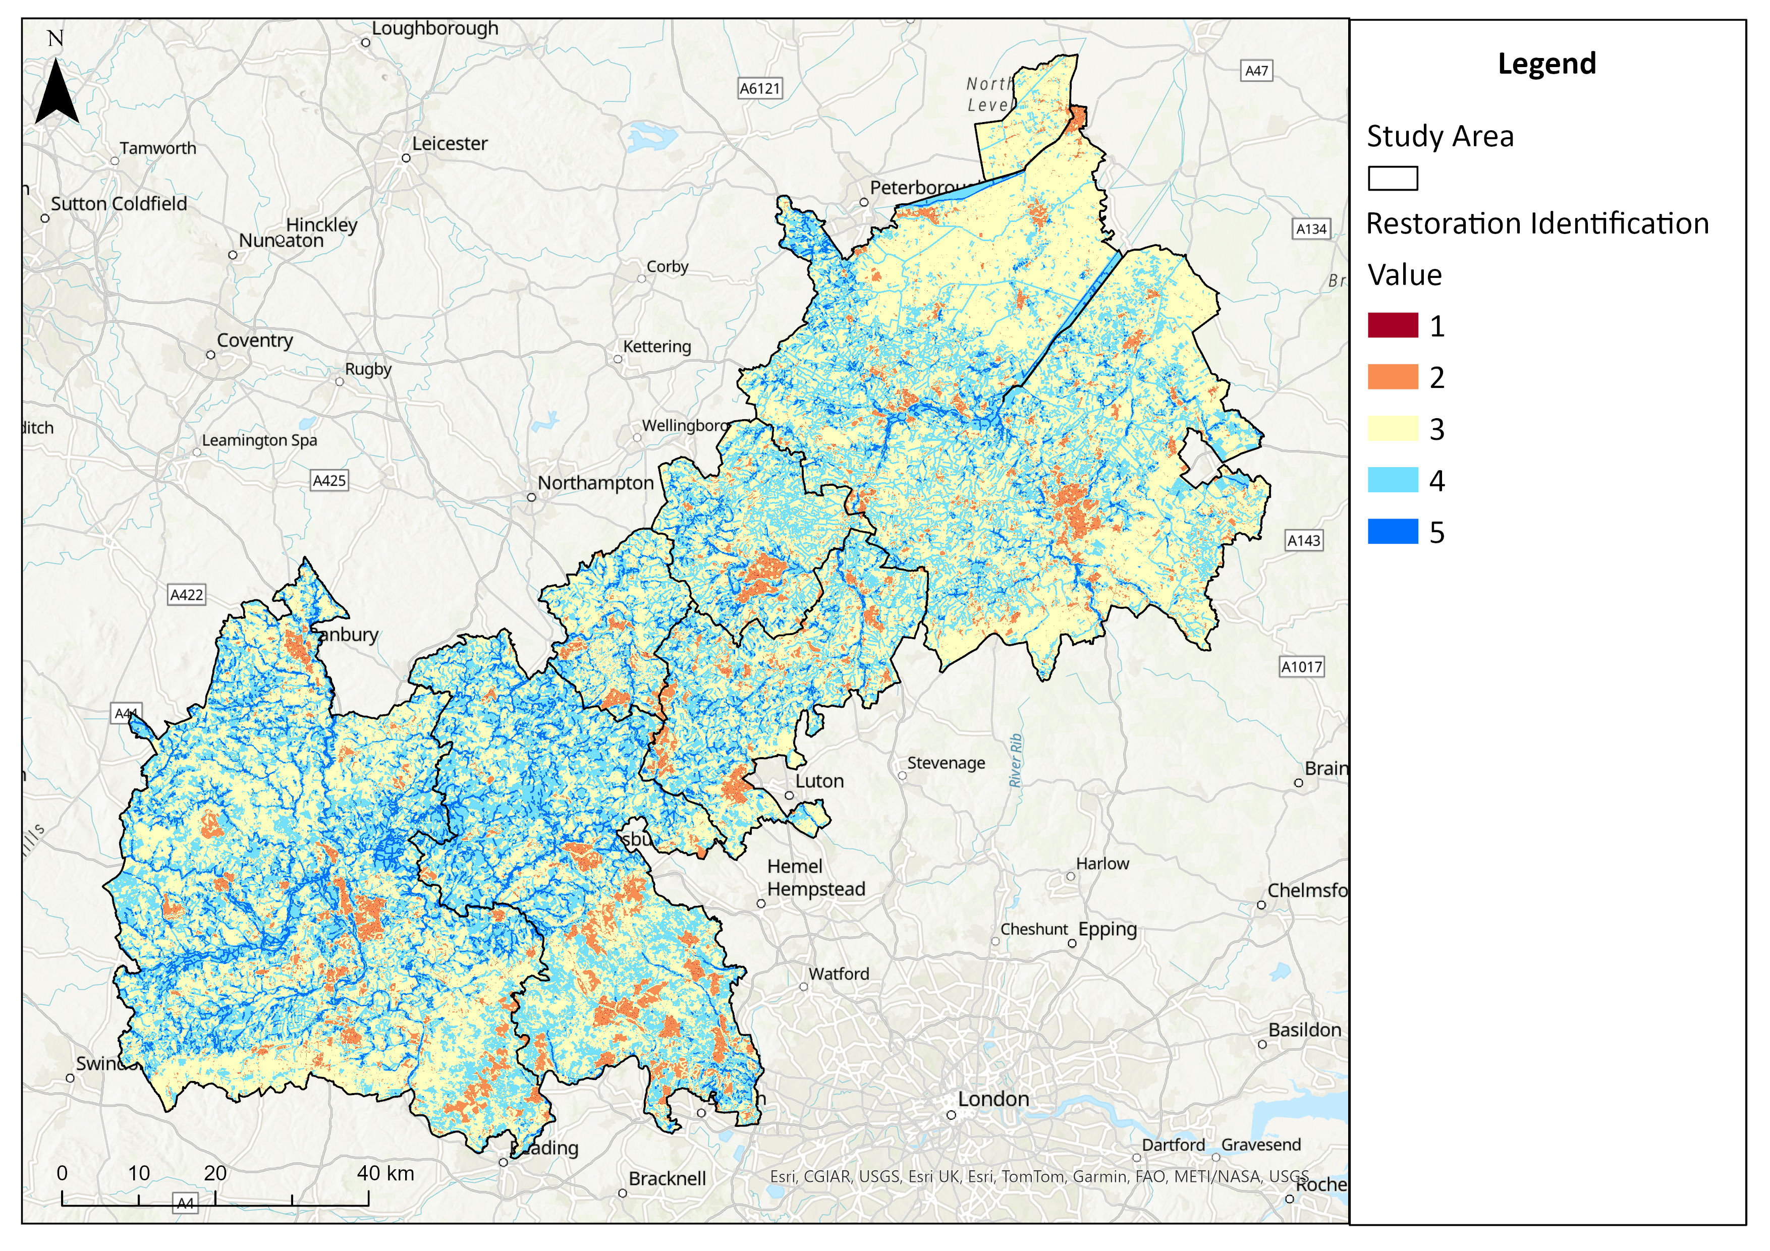
A visual representation of the scoring system used to identify re-meandering opportunities

Slide 9
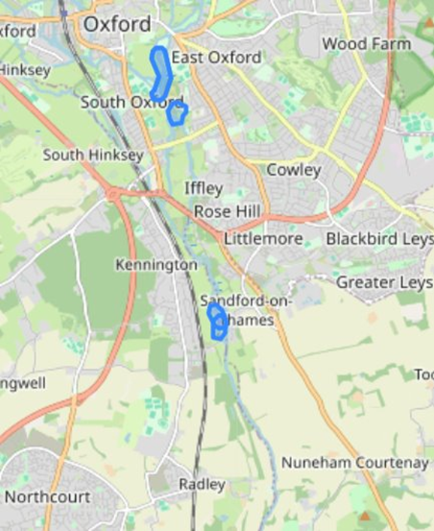
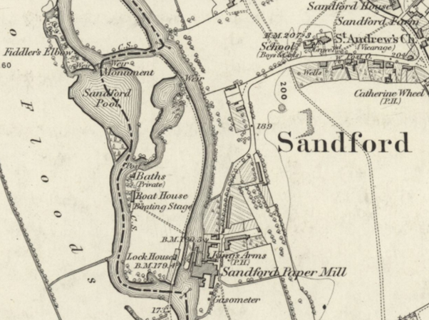
CASE STUDY: REMEANDERING DOWNSTREAM
3913 watercourses within appropriate areas for re-meandering; filtered for those that are in flood risk zones, where re-meandering could be used as a natural flood defense – Sandford-on-Thames is a potential site of re-meandering,
This section has a sinuosity of 1.09
The Oxford Flood Alleviation Scheme aims to create a 'wetland wildlife corridor' by creating a new stream at Kendal Copse, however, re-meandering the Thames / Churwell offshoot of the Thames could provide an alternative
Map from 1886
Notes:
From the 3913 watercourses that are within appropriate areas for re-meandering, we identified 25 within flood risk zones. This section of the Thames in Sandford upon Thames just below Oxford could be an ideal candidate for re-meandering as a flood prevention measure. There are already plans by the Oxford Flood Alleviation Scheme to build a new stream in this area West of Oxford to divert water away from the urban area – however river re-meandering could be an alternative or complementary measure.

Slide 10
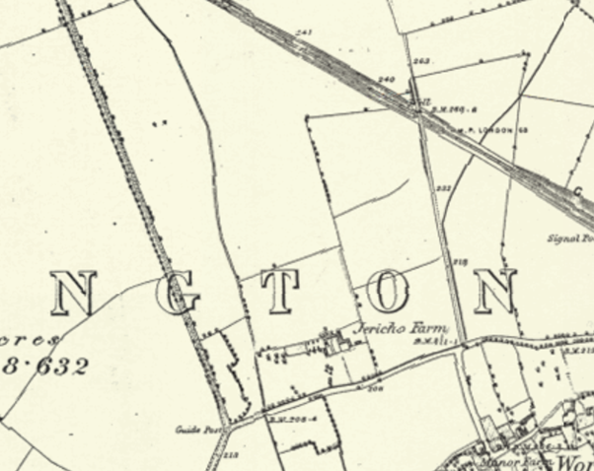
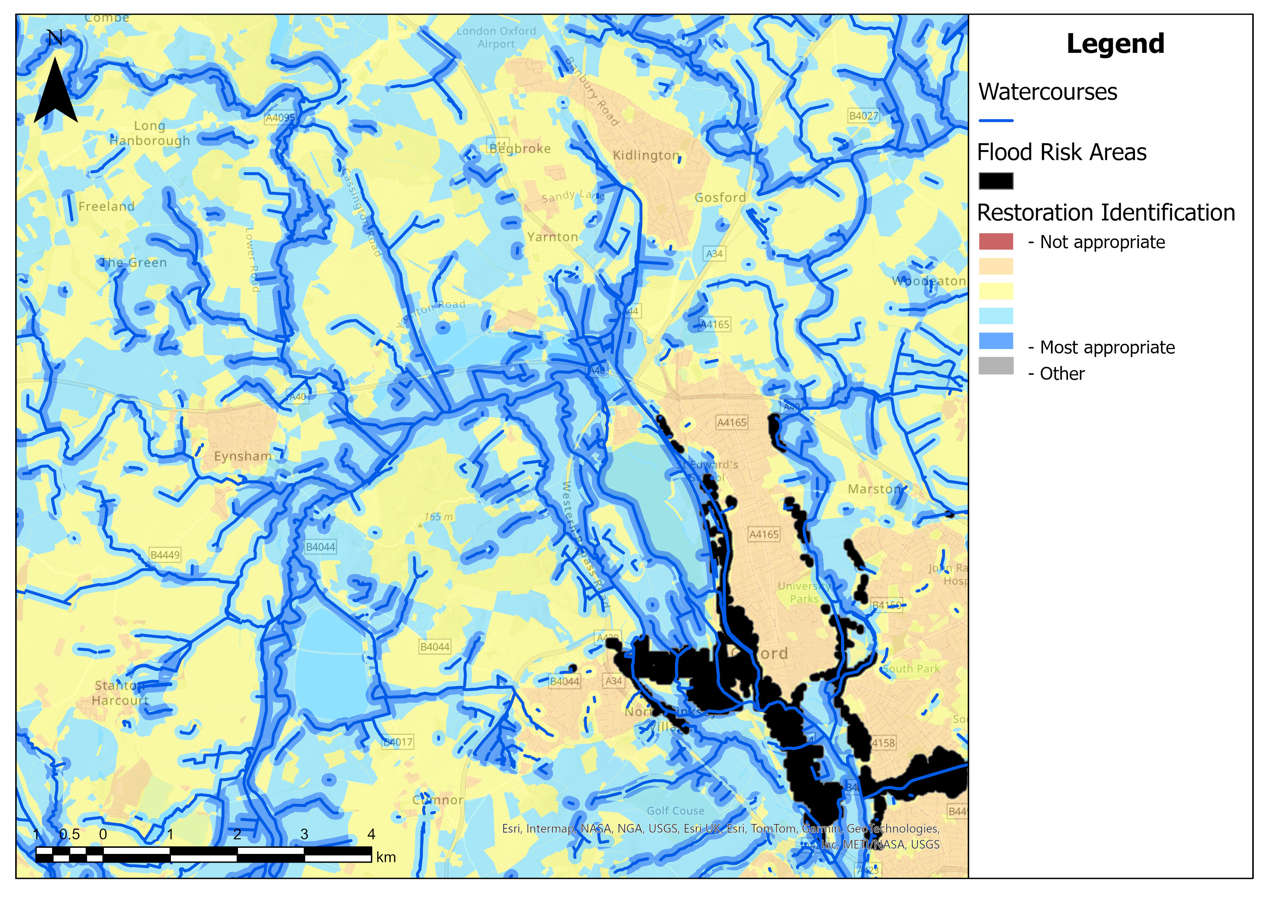
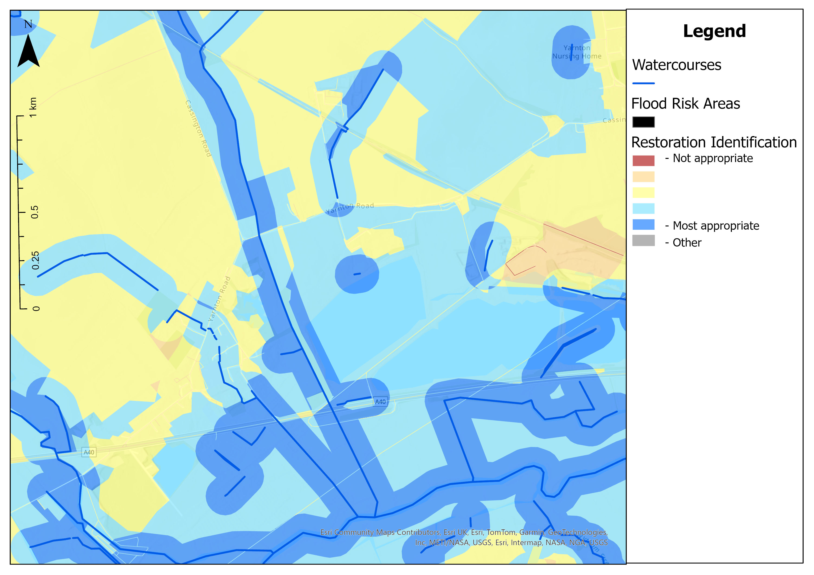
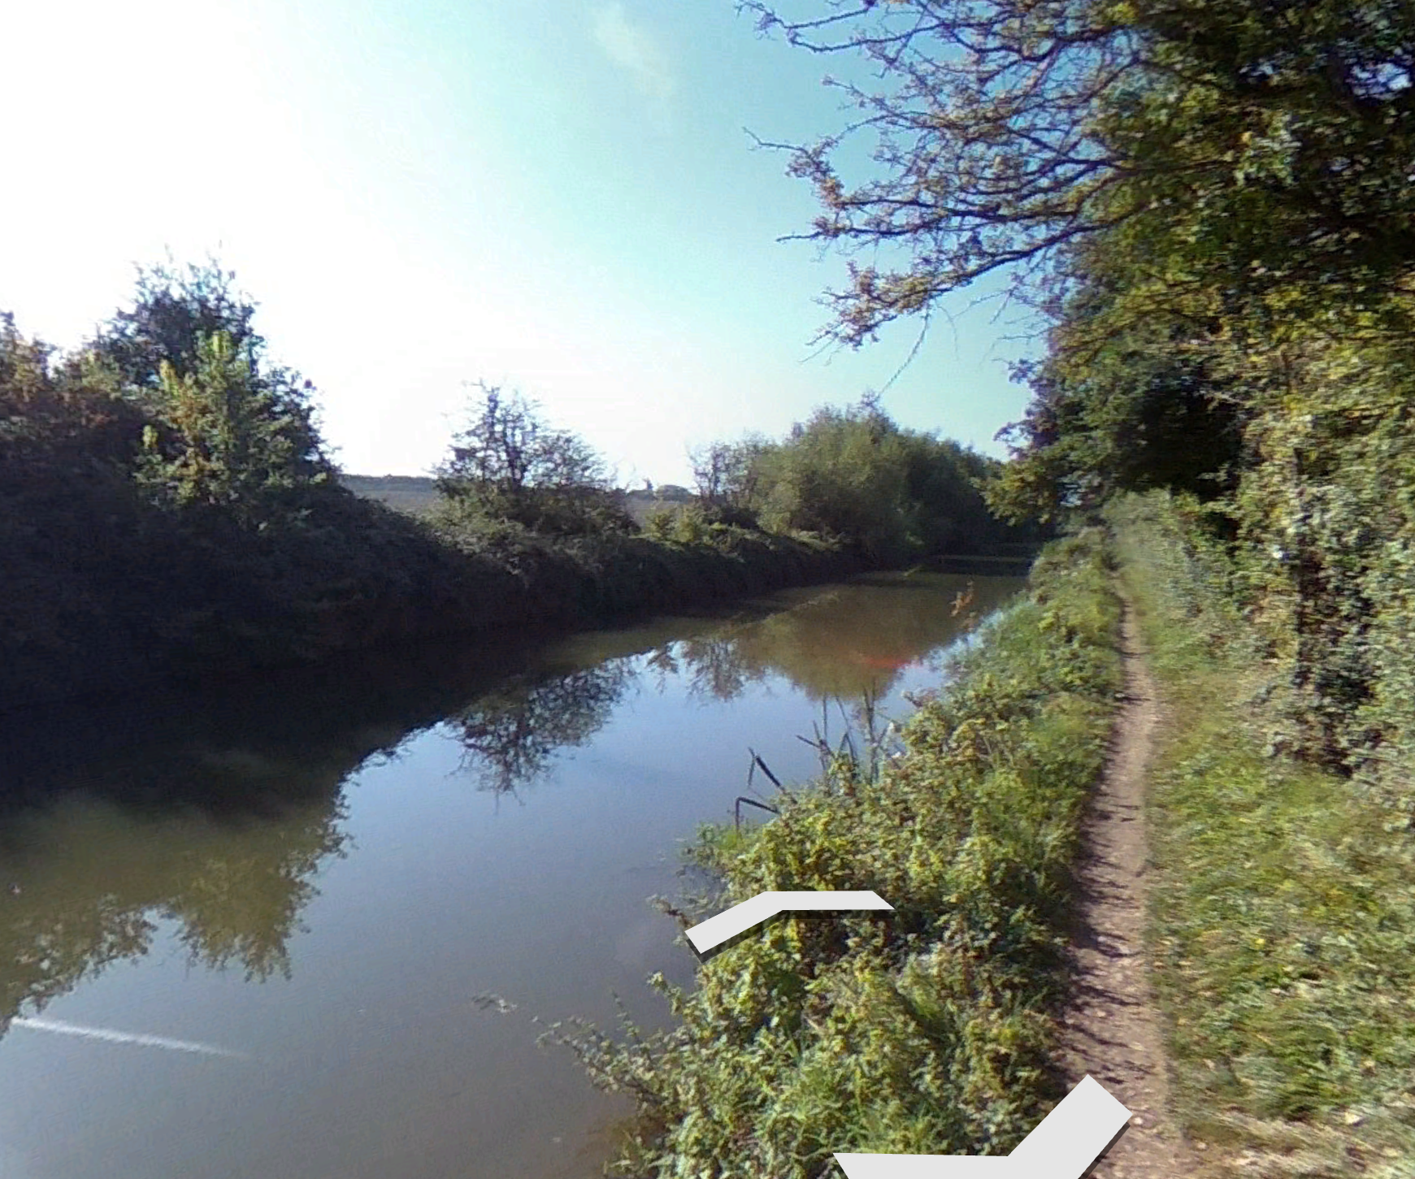
CASE STUDY: RE-MEANDERING UPSTREAM
Example stream north of Oxford, appropriate for re-meandering.​
Map from 1876

Slide 11
1
3
2
6
4
5

Slide 12
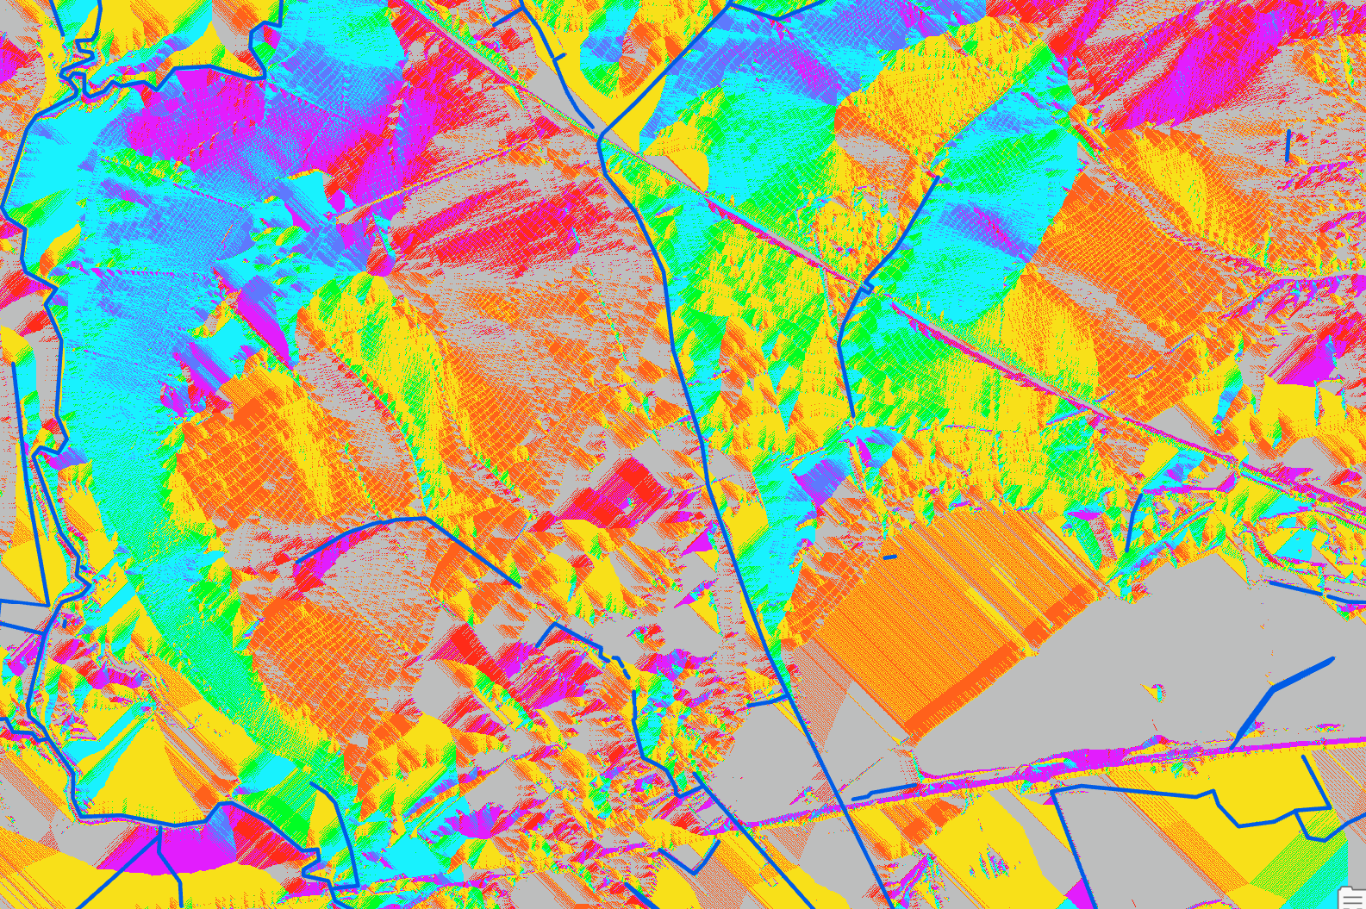
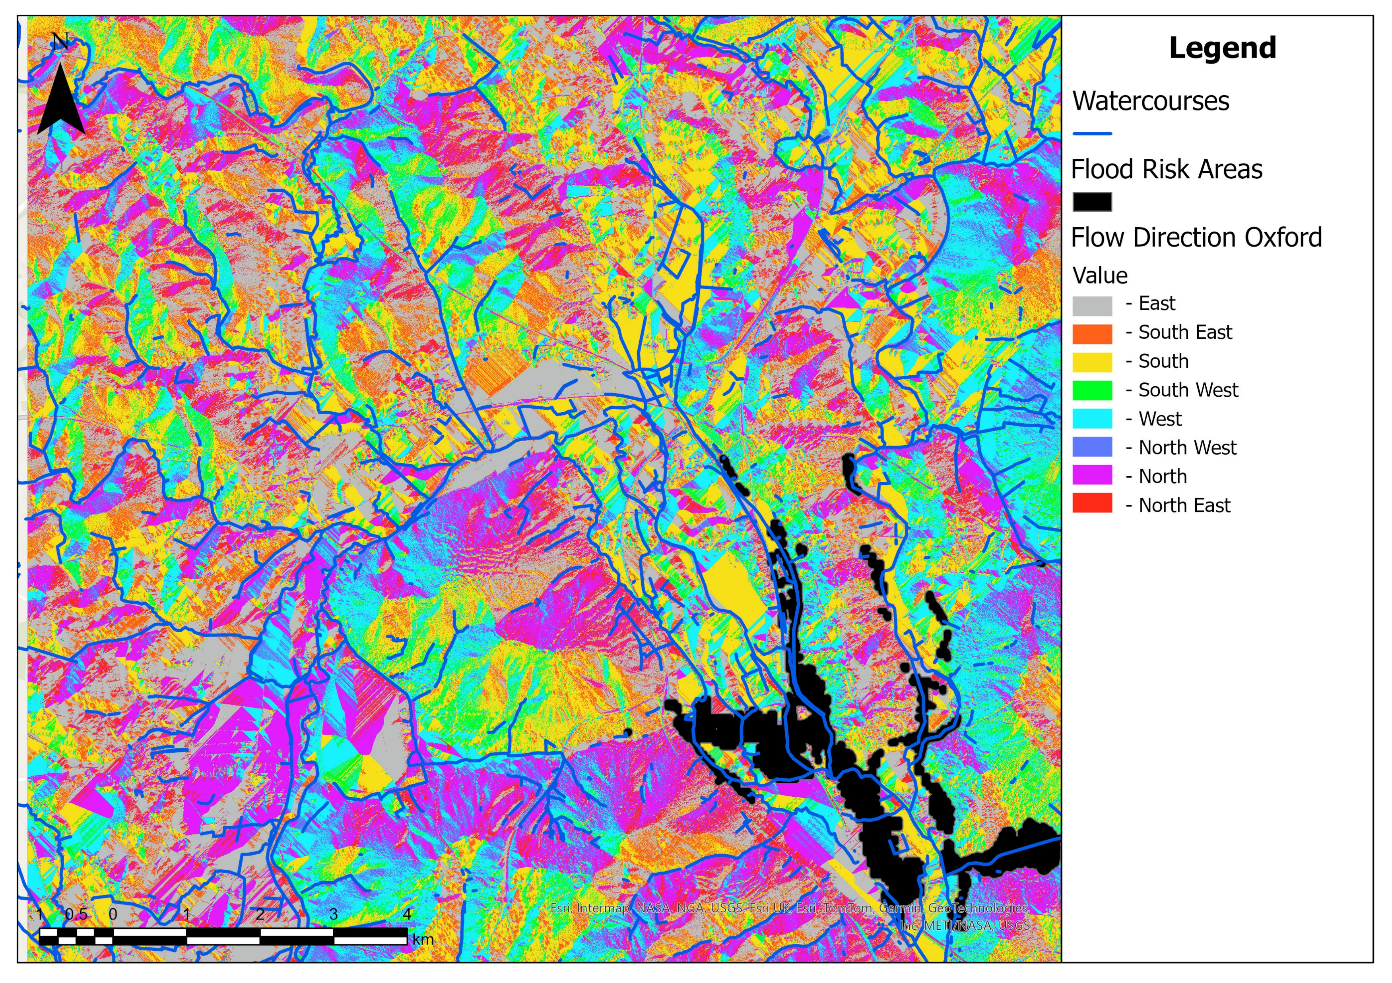
CASE STUDY: RE-MEANDERING UPSTREAM

Slide 13
FUTURE WORK & LIMITATIONS
Further refine selection process for re-meandering
Further hydrology modelling to highlight watercourses in need of restoration based on flood risk areas, e.g. flow accumulation and channel velocity
Define types of watercourses further, e.g. river, canal, beck, stream, levee dykes
Calculating sinuosity is limited by the granularity of the waterway data and the distance between nodes. Finer grain data would allow for more realistic estimation of sinuosity
Application on a national scale
Multi-criteria weighted analysis is split equally between the four variables, further research needed to understand appropriate weighting adjustments
Terrain modelling could be included within the multi-criteria analysis
Vector data was transformed in raster using 2x2m cells, this could lead to distortion of boundaries

Slide 14


THANK YOU!
Any questions?

Slide 15
REFERENCES
Jones, J., Börger, L., Tummers, J., Jones, P., Lucas, M., Kerr, J., Kemp, P., Bizzi, S., Consuegra, S., Marcello, L. and Vowles, A., 2019. A comprehensive assessment of stream fragmentation in Great Britain. Science of the total environment, 673, pp.756-762. [online] [Accessed 21/03/2025] Accessed from: https://doi.org/10.1016/j.scitotenv.2019.04.125
Sandford on Thames Parish Council https://sandford-on-thames-pc.gov.uk/flood-alleviation-scheme/
Soar, P. and Thorne, C., 2001. Channel Restoration Design for Meandering Rivers. [online] US Army Corps of Engineers - Engineer Research and Development Center. [Accessed 26/03/2025] Accessed from: https://www.researchgate.net/profile/Colin-Thorne/publication/235091933_Channel_Restoration_Design_for_Meandering_Rivers/links/0a85e52dd0e640ff00000000/Channel-Restoration-Design-for-Meandering-Rivers.pdf
National Libraries of Scotland, historic maps. Accessed from: https://maps.nls.uk/
Oxford Flood Alleviation Scheme https://consult.environment-agency.gov.uk/thames/oxfordscheme/
Zhou, T. and Endreny, T., 2020. The straightening of a river meander leads to extensive losses in flow complexity and ecosystem services. Water, 12(6), article 1680. [online] [Accessed 21/03/2025] Accessed from: https://doi.org/10.3390/w12061680

